Slide 1
ANALYSIS OF CONSUMER BEHAVIOR OF A FMCG COMPANY
Sankhya Analytics
Guided by: Aditya Nagaraja
Vinayak Deshpande
Gargi Rajadnya, Maryam Ahmad, Vedant Limaye

Slide 2
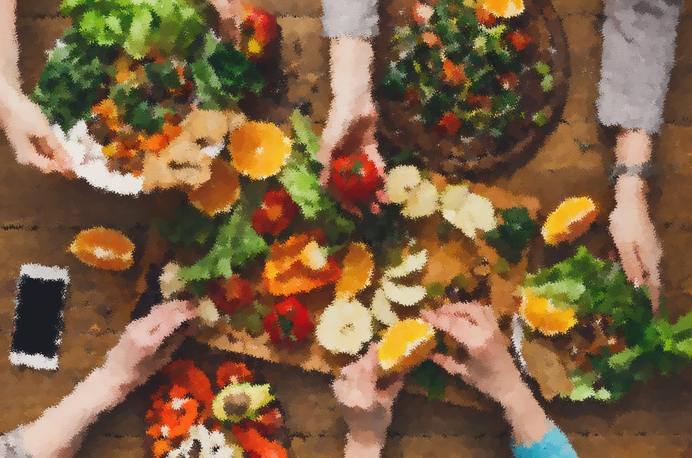

INTRODUCTION
Understand consumer behavior and suggest immediate action marketing strategies
Real-time data of an FMCG company from the Sankhya Analytical Research Firm led by Mr. Vinayak Deshpande Sir.
B2B company
Multiple Channel Partners who sell the company’s products to the public.
The data is from 2018 and 2019.

Slide 3
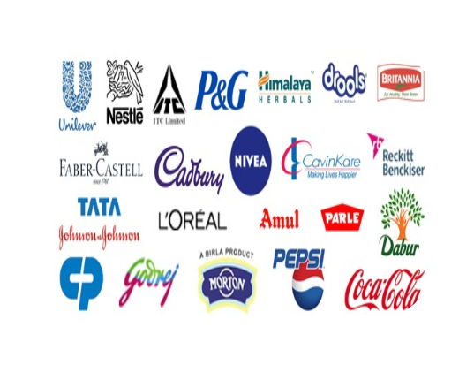

OBJECTIVES
01
To identify which Channel partners responded to the launch of a new product and who to target first in the next planned campaign
02
Understand Consumer Behavior for both the Channel Partners and the end consumers
03
To develop scientific method of communication for the next planned campaigns

Slide 4
STEPS
DATA MANAGEMENT
Compiling data files, data cleaning, Created variables
DESCRIPTIVE STATISTICS &
DATA VISUALIZATION
Understanding the data better and presenting it visually
PREDICTIVE MODELLING
Answer objectives, using different Predictive model techniques- find Significant variables
TEXT MINING
Understand customer responses using various Text mining Techniques and answer Objective 1

Slide 5
VARIABLES
Sales in 2018
SMS
Sales in 2019
Call
Response Rate
Email
Buying Frequency(2019)
Portal
Buying Frequency(2019-B1)
Rewards
Active Partners(2019)
Loyalty
Active Partners(2019-B1)
Region
Brand Engagement(2019)
Sales
Brand Engagement(2019-B1)
No. of Complaints
NPS
Net Promoter Score
Buying Intervals
No. of years

Slide 6

DATA MANAGEMENT:
DATA MANAGEMENT:
Created a master file using all data files
Applied basic data checks like dimension or structure of the data
Dropped irrelevant columns and merged with the other files and derived variables.
Finally, composed a master file

Slide 7

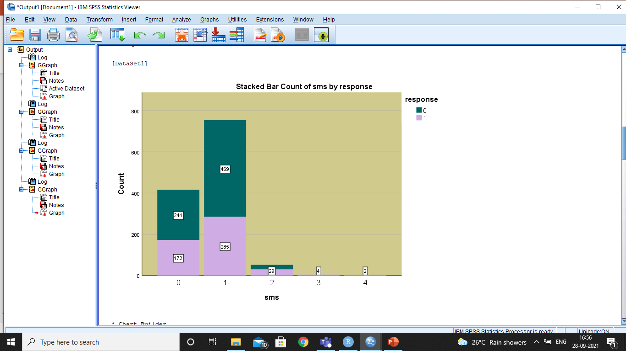
VISUALIZATION
With the help of SPSS, visualization for responses according to the factors is produced.
10

Slide 8
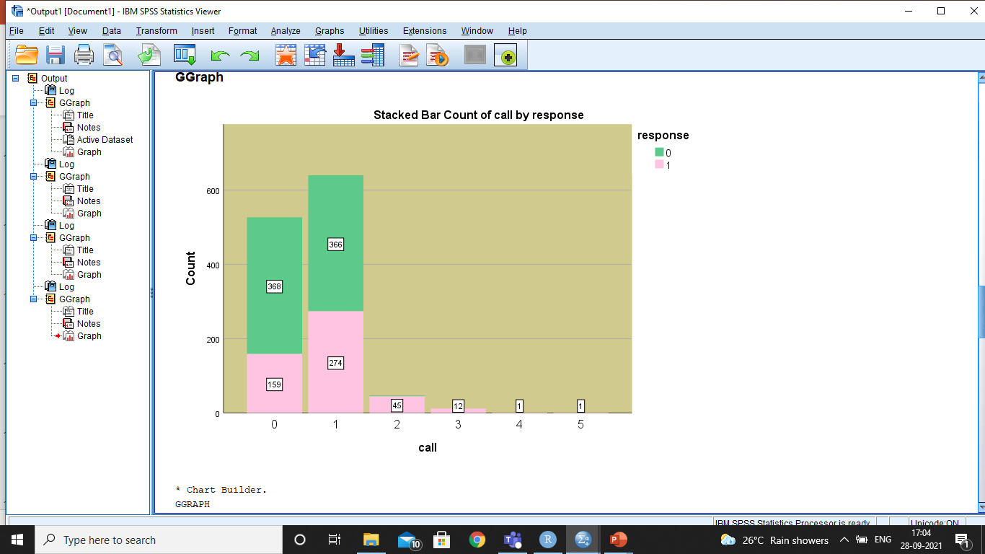
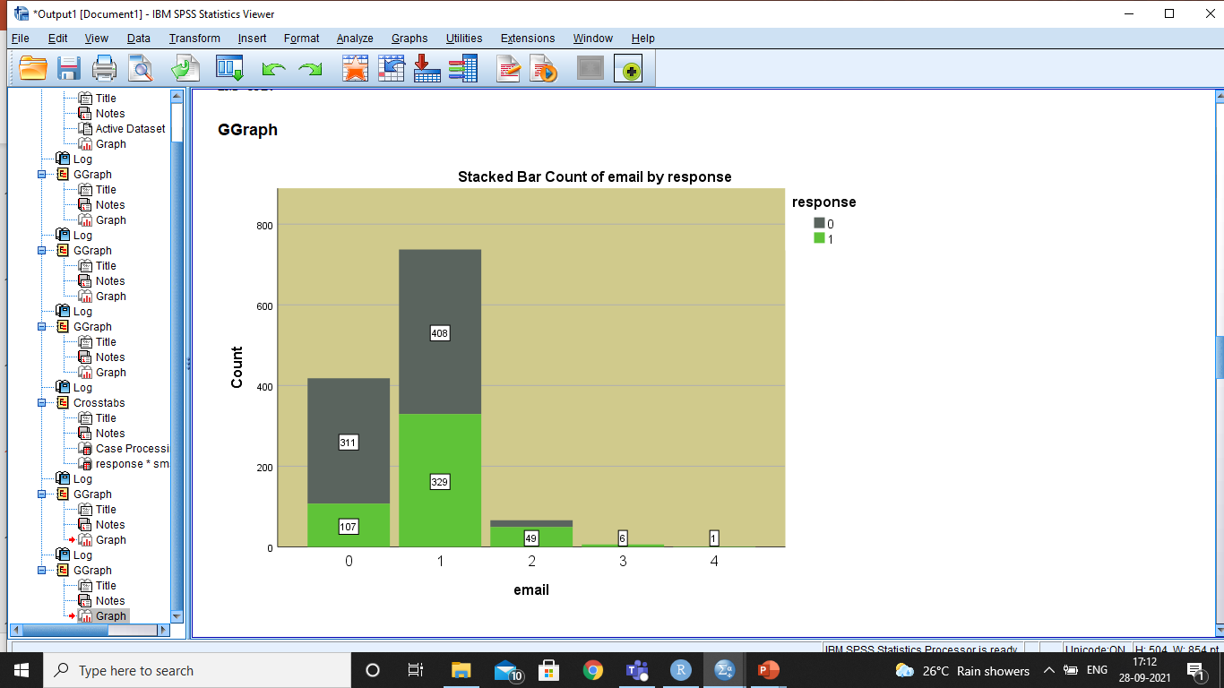
VISUALIZATION- FACTORS

Slide 9
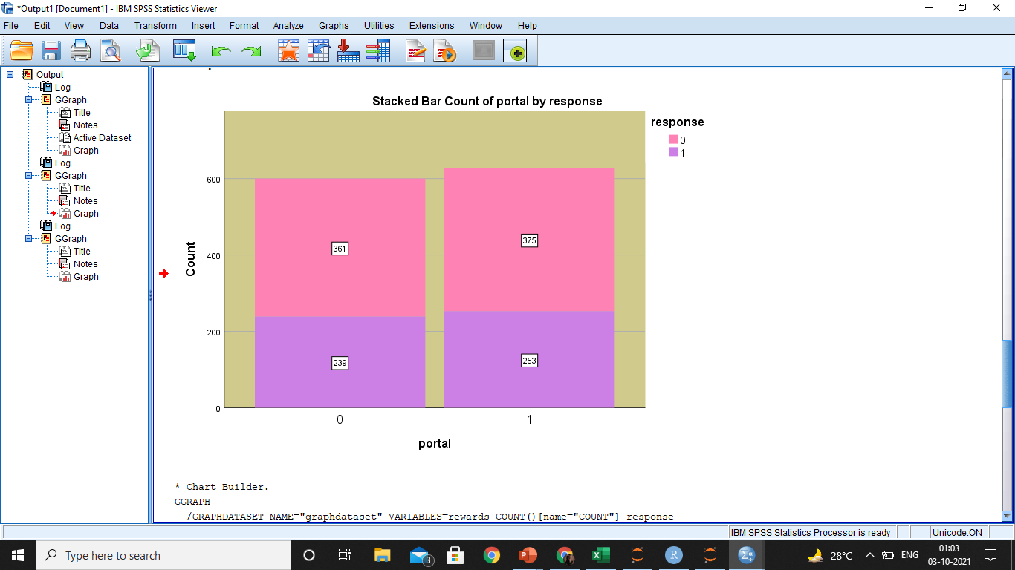
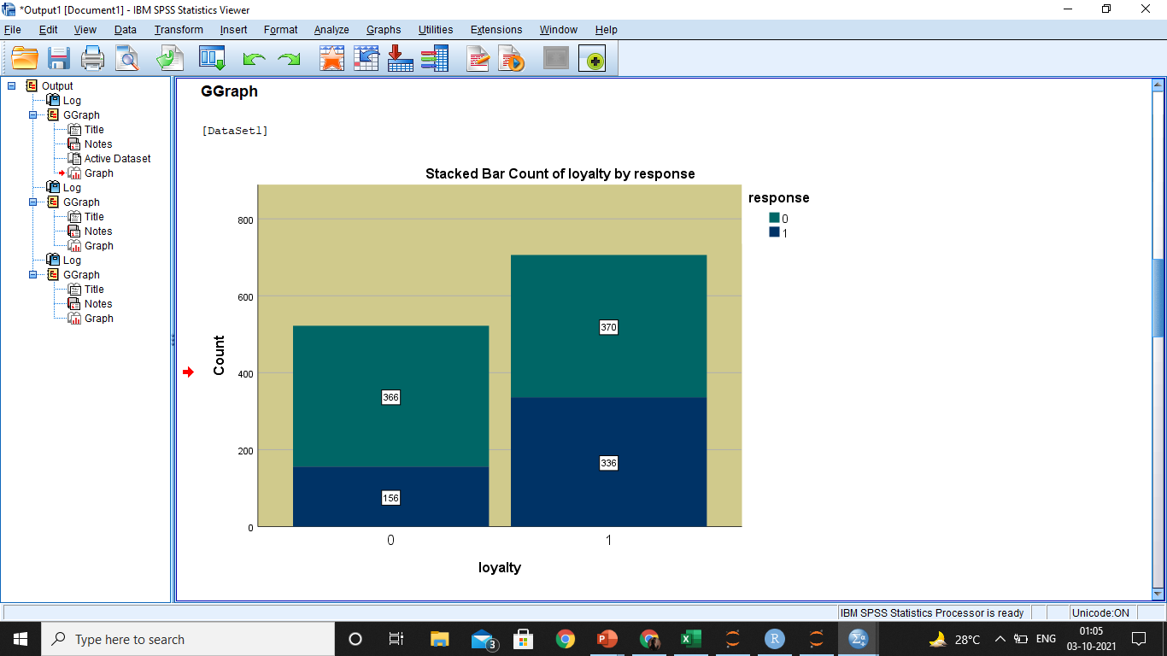
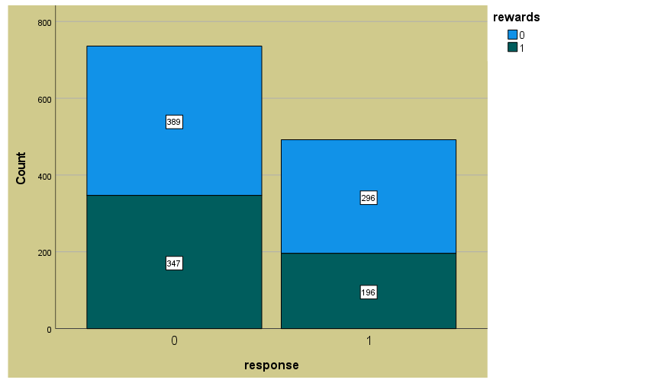
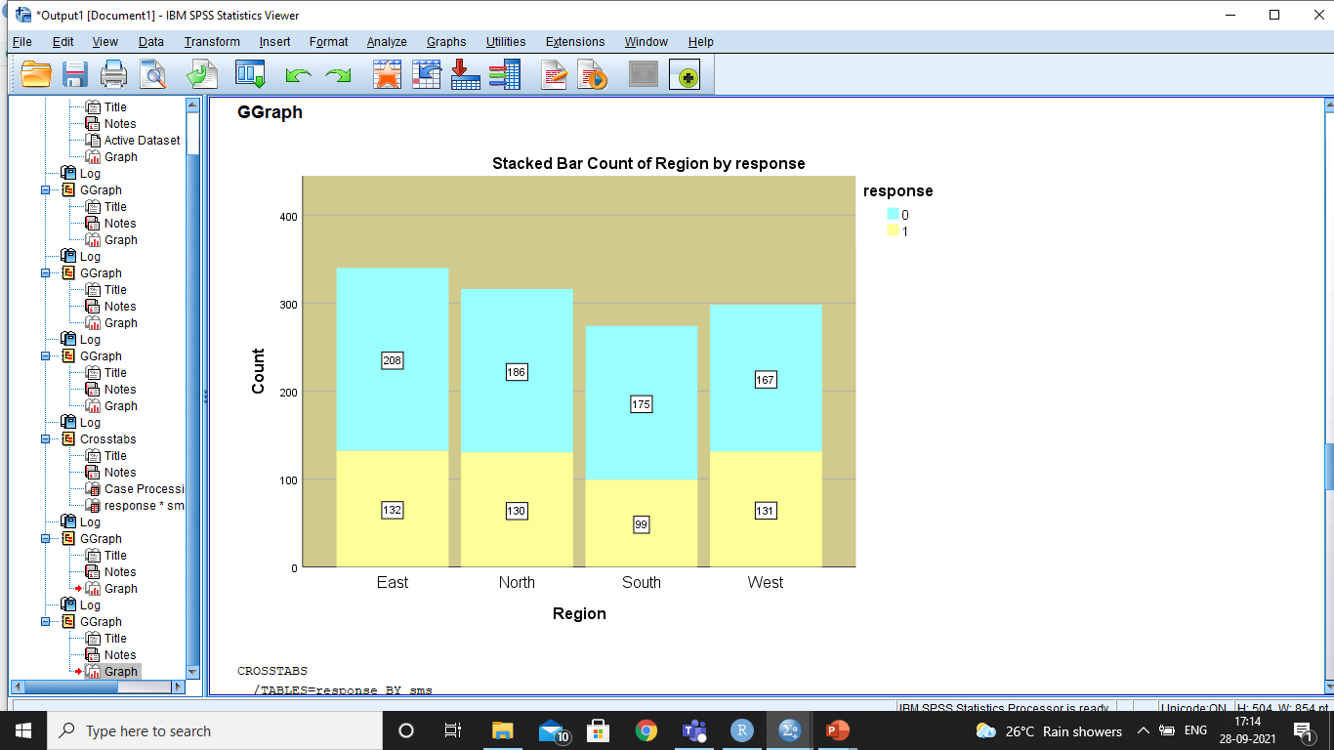
Stacked Bar Count of rewards by response

Slide 10
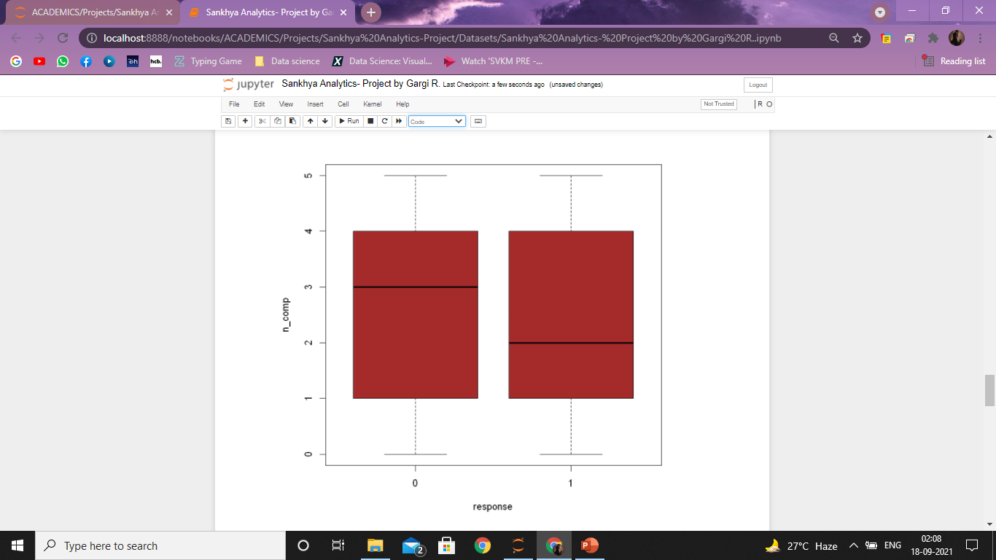
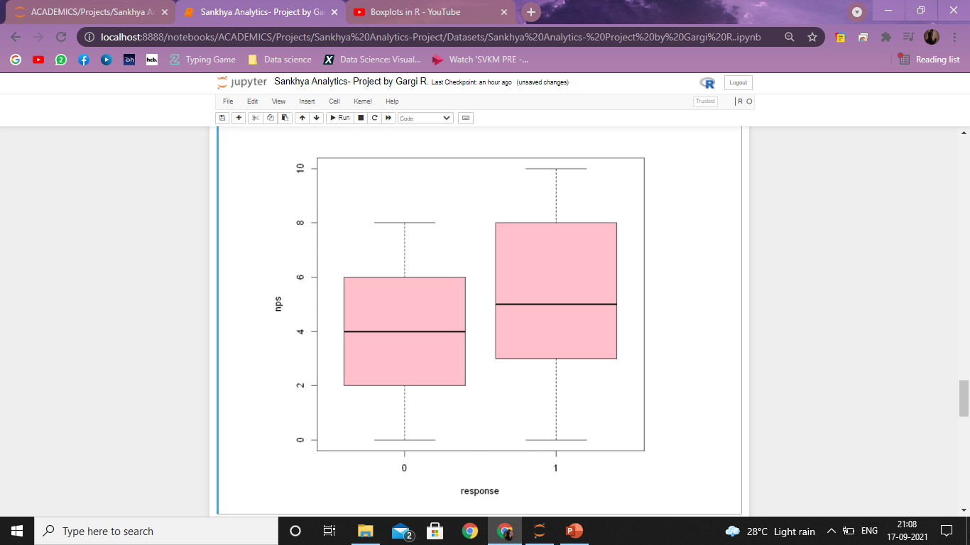
VISUALIZATION- COMPLAINTS AND NPS

Slide 11
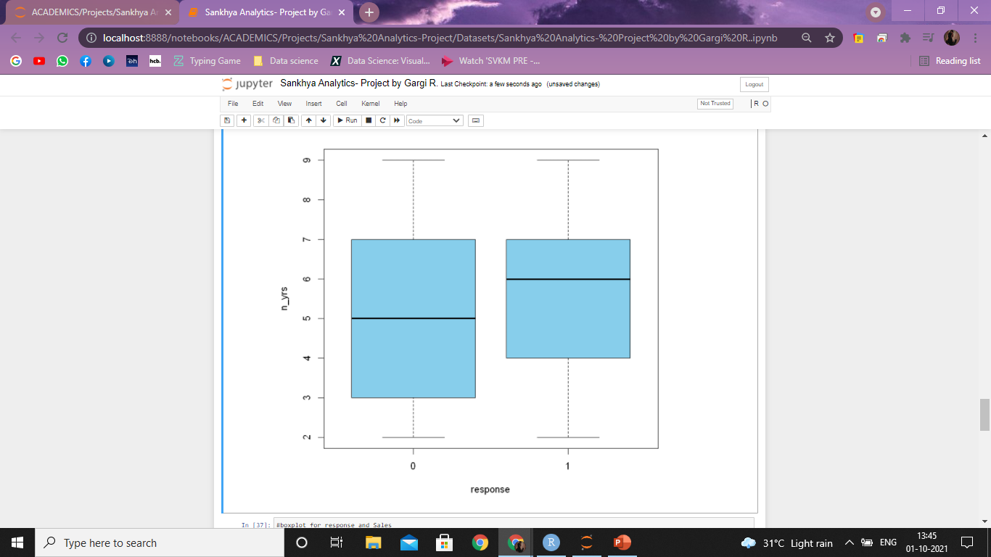
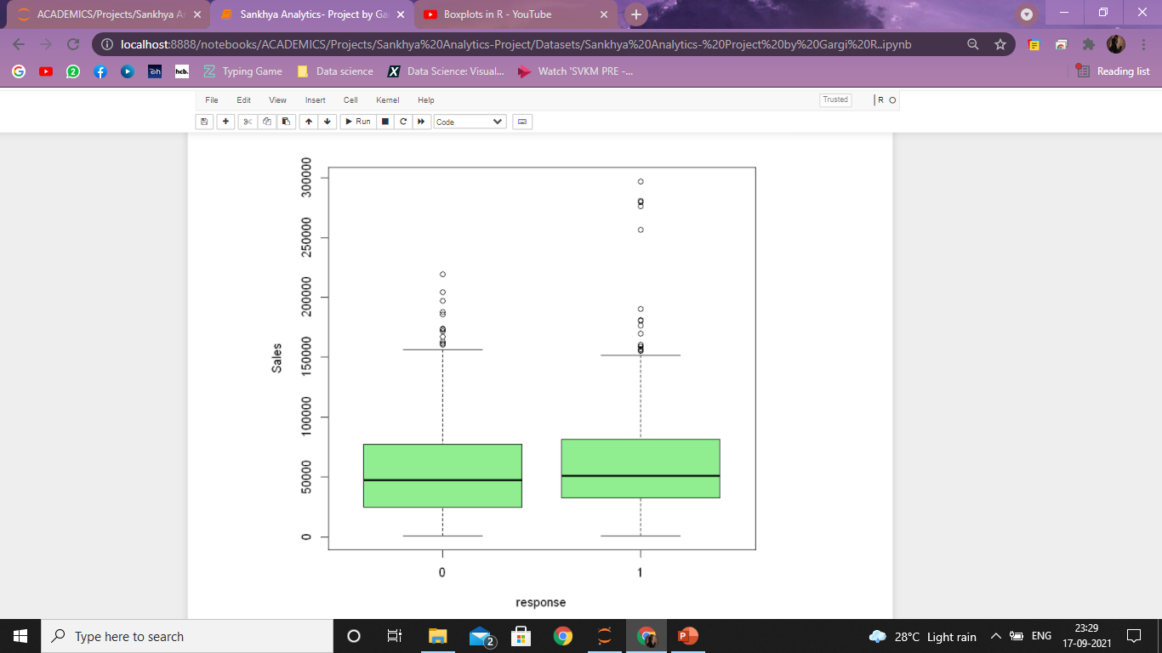
VISUALIZATION- NO. OF YEARS AND SALES

Slide 12
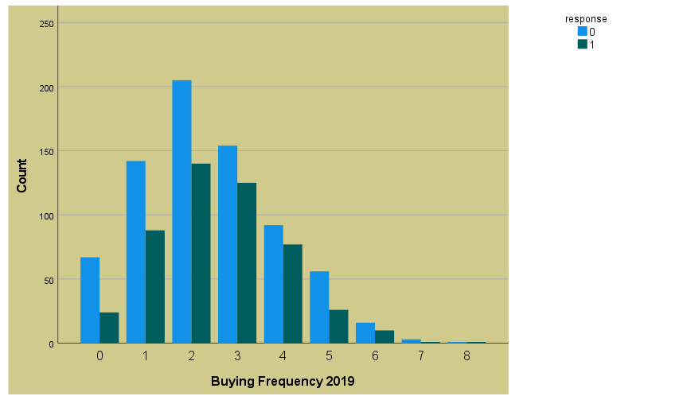
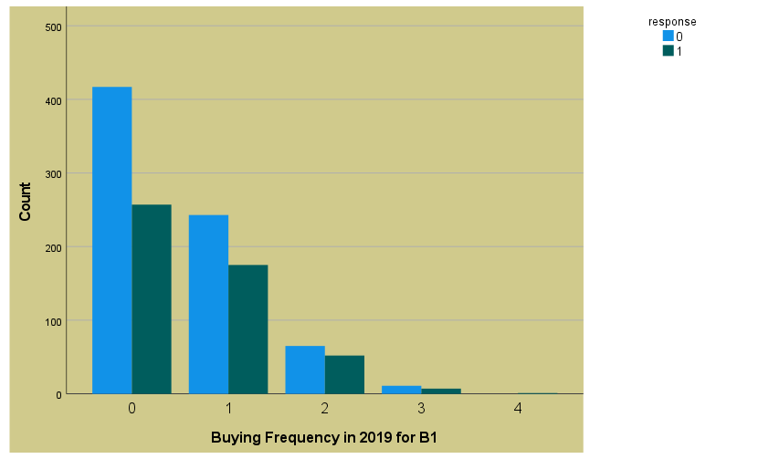
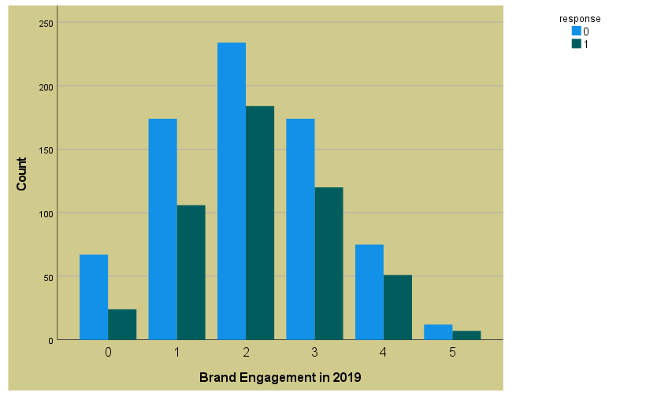
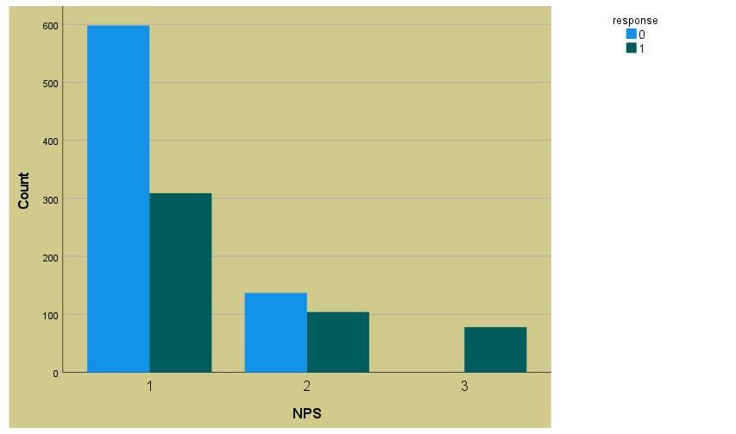

Slide 13
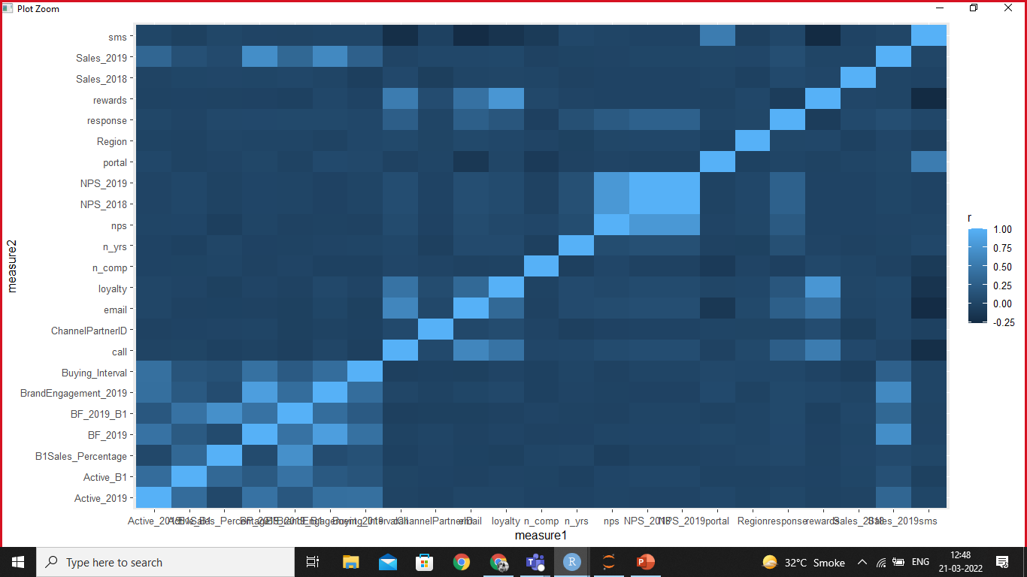
VISUALIZATION
Correlation heatmap is graphical representation of correlation matrix representing correlation between different variables.
The value of correlation can take any values from -1 to 1.
It can be inferred that there is a high correlation between SMS and several other variables, so we will remove SMS from the predictive modeling.
HEATMAP

Slide 14

MODELING:
Logistic regression is used to describe data and to explain the relationship between one dependent binary variable(dichotomous) and one or more nominal, ordinal, interval or ratio-level independent variables.
Here the dependent variable is responses- 1: Yes, 0: No

Slide 15

INFERENCE:
Significant Variables:
Email
Call
Loyalty
Rewards
Sales 2019- derived variable
NPS- derived variable
VIF:
All the variables < 5 and hence they are between normal range. NO MULTICOLLINEARITY

Slide 16








TEXT MINING:
Import and Convert into corpus
Clean Corpus
Inspect Corpus
Frequency terms
Words associated with frequency terms
Matrix
Word Cloud

Slide 17
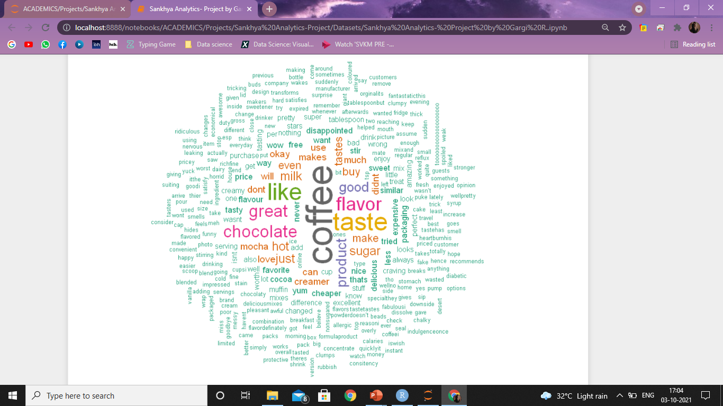
WORD CLOUD
INFERENCE
Most used words are coffee, taste, like, flavor, good, etc.
From the word cloud we can conclude that there are more positive reviews.

Slide 18
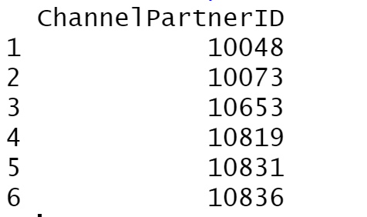
CONCLUSION 1
POSITIVE RESPONSE AND TARGET
Here’s a list of the Channel Partners that responded positively for the launch of the new product.

Slide 19
CONCLUSION 2
UNDERSTANDING CONSUMER BEHAVIOR
Channel Partners who have a loyalty membership and redeem the rewards more, are more prone to have a positive response and are more willing to support the launch of the new product by the company.
Improve relationship with the Channel Partners: Decreased number of complaints, better reward system, Part payment, extra credit, balance.
End consumers love the flavor of the product. Use it in various recipes.

Slide 20
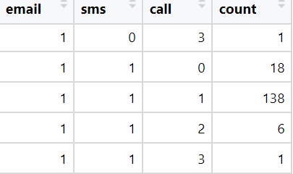
CONCLUSION 3
SCIENTIFIC METHOD OF COMMUNICATION
Here’s an analysis on which type of communication worked well for the company and what they should continue to pursue and have a standard means of communication with the Channel Partners.
Call=1, SMS=1, Email=1

Slide 21

CONCLUSION:
According to the pre-covid data provided by the company, it sought recommendation on dealing with the pandemic situation with new marketing strategies complementing the pandemic situation.
The main strategy which we came up with to immediately deal with the pandemic was to connect with the end consumers directly and also simultaneously focus on improving relationship with the existing Channel Partners.

Slide 22
STRATEGY
SEO/ SEM: Search Engine Optimization/Marketing
Website: Create a website and connect with the consumers directly.
SMM: Social Media networks like Facebook, Instagram, Twitter, Youtube, and LinkedIn.

Slide 23
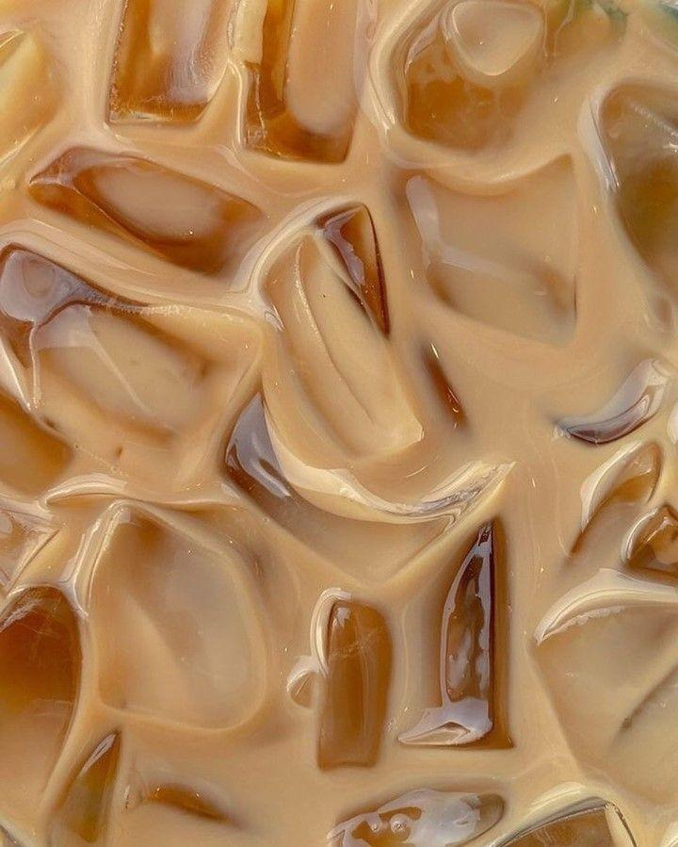
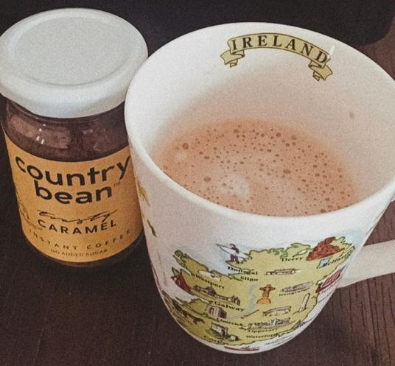
CASE STUDY- COUNTRY BEAN
India’s 1st flavoured coffee brand
D2C, SEO, SEM, SMM
>2Lakh customers
“The Internet has made it possible to run a national or even a global business from your bedroom”
STRATEGY
Instagram presence
Stories, Reels, Memes
‹#›

Slide 24
ACKNOWLEDGEMENT
This project would not have been possible without the guidance of our Marketing professor, Aditya Nagaraja Sir and Vinayak Deshpande sir.
Thank you to both the mentors.
We would like to thank NMIMS deemed to be university for providing us with this opportunity.

Slide 25




Gargi Rajadnya, Maryam Ahmad, Vedant Limaye
Emails: Gargi, Maryam, Vedant
LinkedIn: Gargi, Maryam, Vedant
THANK YOU!

